Slide 1
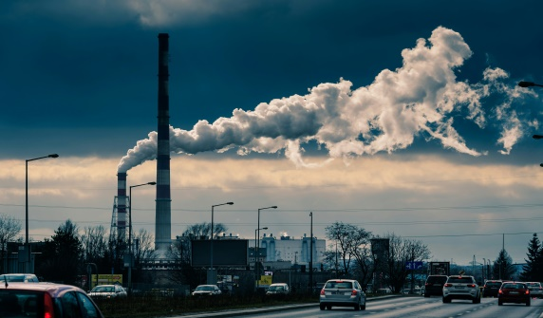

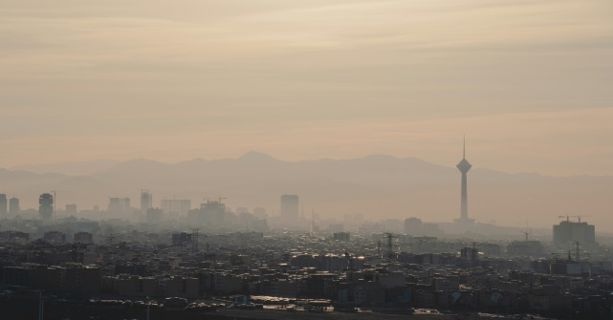
The Air We Breathe: A National Analysis of India’s Air Pollution Crisis
Data-Driven Insights into Urban Air Quality and Pollutant Trends
Presenter Name: LOPAMUDRA ROY

Slide 2
1. Introduction
2. Problem Statement
3. Dataset Overview
4. Data Cleaning & Preparation
1. Introduction
2. Problem Statement
3. Dataset Overview
4. Data Cleaning & Preparation
5. Tools & Technologies Used
6. Dashboard Overview
7. City days-wise AQI Analysis
8. Pollutant-wise Analysis
5. Tools & Technologies Used
6. Dashboard Overview
7. City-wise AQI Analysis
8. Pollutant-wise Analysis
9. AQI Category Distribution
10. Trend Analysis
11. Key Insights & Findings
12. Conclusion & Future Scope

Slide 3

INTRODUCTION TO MY TOPIC
Air pollution is a major environmental and health issue in India caused by rapid urbanization, industrialization, and increasing vehicle emissions. Many Indian cities regularly exceed safe air quality limits, leading to serious health problems. This project uses Power BI to analyze air pollution data across India and identify trends and regional patterns.

Slide 4
Problem statement
Air pollution levels in major Indian cities remain high despite control measures. There is limited clarity on how pollution changes over time across cities. This project uses Power BI to analyze city-wise air quality trends and identify problem areas.

Slide 5
Dataset->Cleaning->Technology used
Dataset
Extracting dataset from excel, where I have major Indian cities, many pollutant, day field, to show changes in air pollution over time
Cleaning
Unnecessary column was removed, and by checking all data was proper
Technology
MS EXCEL, POWERBI, MS POWERPOINT

Slide 6
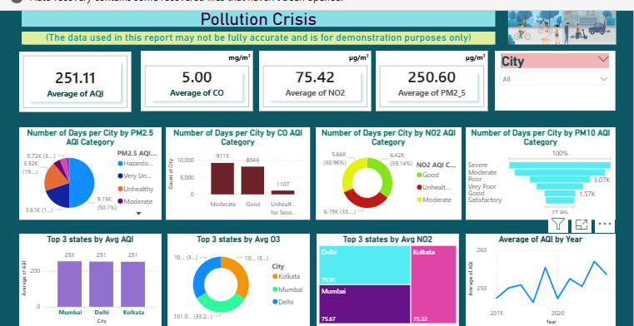
DASHBOARD OVERVIEW
Lets explain the overall view part by part

Slide 7

On KPI Prospective
Project view basis of KPIS

Slide 8
Project Overview & Executive Summary
Objective: To analyze the severity of air pollution across major Indian cities using key indicators like AQI, PM2.5, NO2, and CO.
Key High-Level Metrics:
National Average AQI: 251.11 (Indicates a high pollution baseline).
Total PM2.5 Mass: 4.58M.
Average NO2 Levels: 75.42.
Average CO Levels: 5.00.

Slide 9
Pollutant Breakdown & Health Risk Categories
PM2.5 Distribution: A significant portion of cities fall under "Hazardous" or "Very Unhealthy" categories (see pie chart).
CO & NO2 Categories: * CO levels are predominantly in the "Moderate" to "Good" range for most cities.
NO2 levels show a split, with over 30% of cities reaching "Moderate" pollution levels.
PM10 Status: A funnel analysis showing the distribution from "Satisfactory" to "Severe."

Slide 10
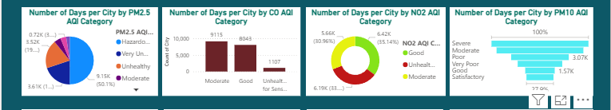
Citi days on pollutant
Basis of number of city days

Slide 11
Pollutant Breakdown & Health Risk Categories
For PM2.5 (Pie Chart): "I calculated the share of total days that fell into critical categories like 'Hazardous' to visualize the proportion of high-risk time."
For CO (Bar Chart): "I compared the absolute count of days side-by-side to clearly show that 'Moderate' and 'Good' days are the most frequent for Carbon Monoxide."
For NO2 (Donut Chart): "I broke down the percentage of days to highlight the ratio of safe days versus unhealthy ones for Nitrogen Dioxide."
For PM10 (Funnel Chart): "I arranged the volume of days in a hierarchy to show how the frequency drops as we move from 'Severe' down to 'Satisfactory' levels."

Slide 12
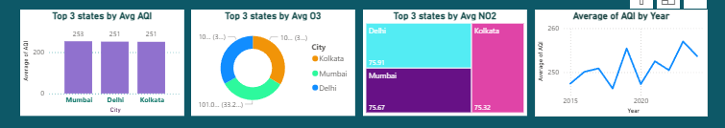
Top States
Basis of 3 top state at a glance

Slide 13
Geographic Hotspots (Top 3 Polluted Cities/States)
Geographic Hotspots (Top 3 Polluted Cities/States)
Highest Average AQI:
Mumbai: 253
Delhi: 251
Kolkata: 251
Pollutant Specifics:
Ozone (O_3): Kolkata leads in Ozone concentration among the top three.
Nitrogen Dioxide (NO_2): Delhi shows the highest average NO_2 (75.91), followed closely by Mumbai and Kolkata.

Slide 14
Conclusion & Recommendations
Summary: Urban centers like Delhi, Mumbai, and Kolkata are consistently exceeding safe air quality limits.
Data Insight: While CO levels remain manageable, PM2.5 and NO2 are the primary drivers of the "Hazardous" AQI ratings.
Call to Action: * Implement stricter industrial emission controls in metro hubs.
Enhance green cover and public transport to reduce NO2 from vehicular exhaust.

Slide 15
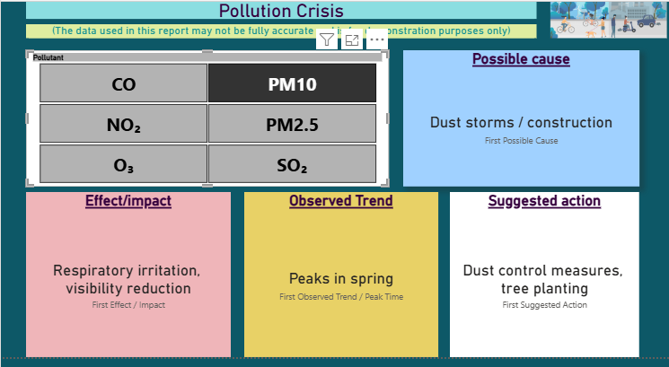
CAUSE->EFFECT->TREND->ACTION

Slide 16
Air Pollution: Root Causes and Observations
Primary Pollutants Identified: The analysis focuses on CO, NO_2, O_3, PM10, PM2.5, and SO_2.
Observed Trends: Data indicates that pollution levels reach "Morning peaks".
Primary Cause: "Vehicle exhaust" is identified as the first possible cause for these elevated levels.

Slide 17
Key Recommendations:
Decarbonizing Transport: Prioritize the transition to Electric Vehicles (EVs) and improve traffic flow to mitigate "Morning Peaks" caused by vehicle exhaust, which the data identifies as a primary pollutant source.
Stricter Industrial Oversight: Implement 24/7 real-time monitoring of $SO_2$ and $NO_2$ in industrial clusters to prevent cities from entering the "Severe" category.
Public Health Safeguards: Use AQI data to trigger "Low-Activity Alerts" during peak hours to protect citizens from respiratory distress and reduced oxygen transport.
Infrastructure & Policy: Expand urban green belts to act as natural $PM_{10}$ filters and enforce cleaner fuel standards across all major metropolitan hubs.

Slide 18
THANK YOU
“Let’s breathe life into our future—take care of the air we share.”

